Slide 1

WIPRO NGA Program – Java full stack
Capstone Project Presentation –29th Aug
Project Title Here – Library Management System
Presented by – Ravi Kumar
www.rpsconsulting.in

Slide 2
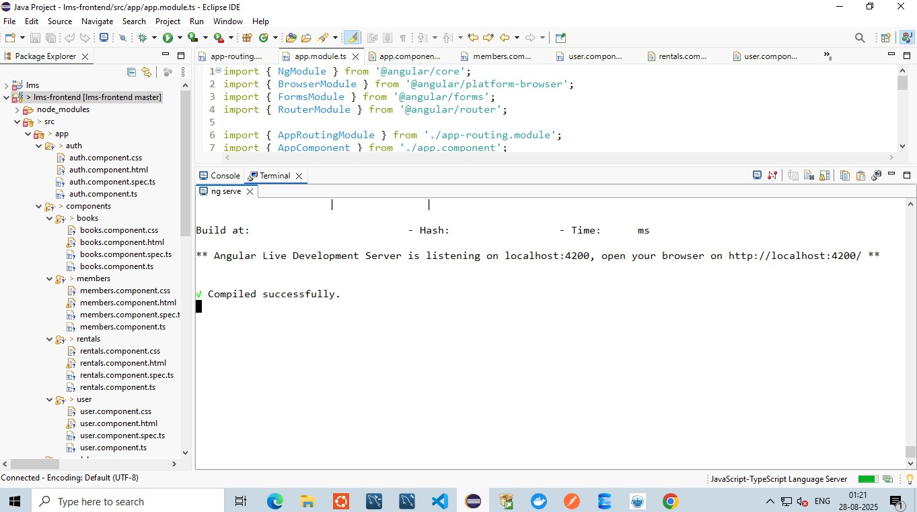

Frontend
2025 - RPS Consulting all rights reserved

Slide 3
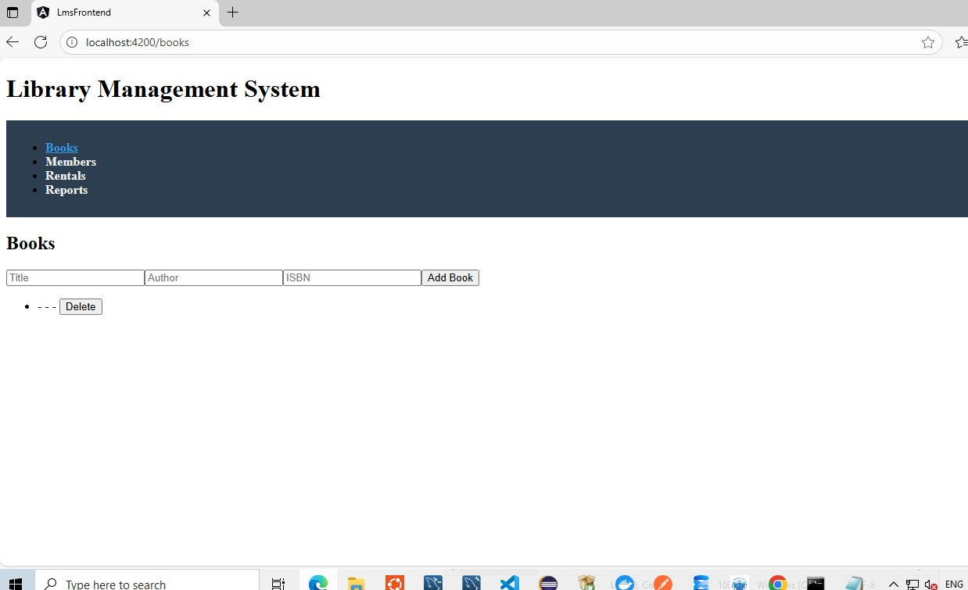

Slide 4
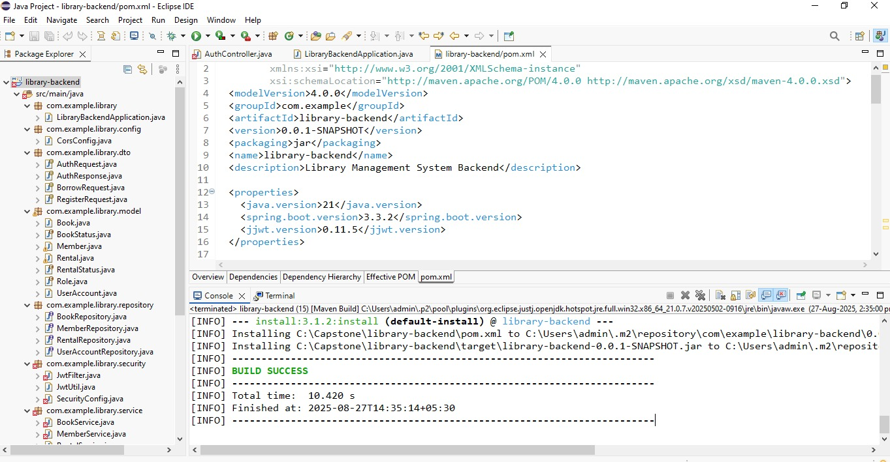
Backend

Slide 5
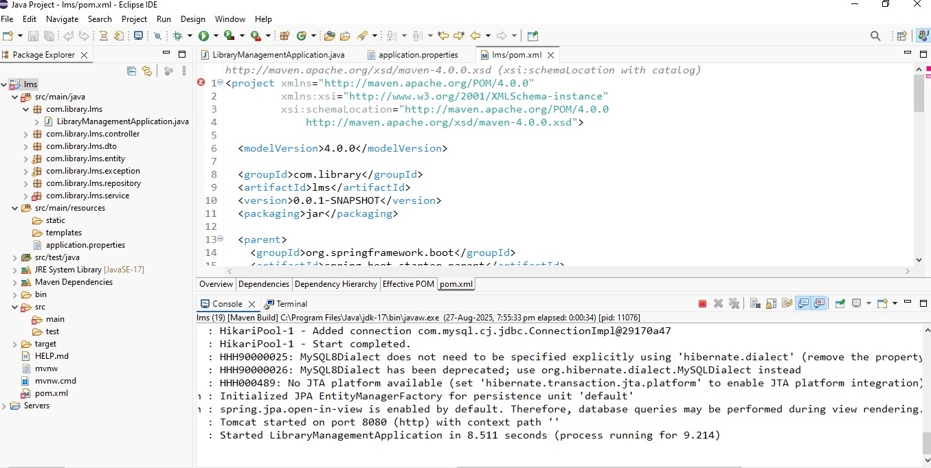

Slide 6
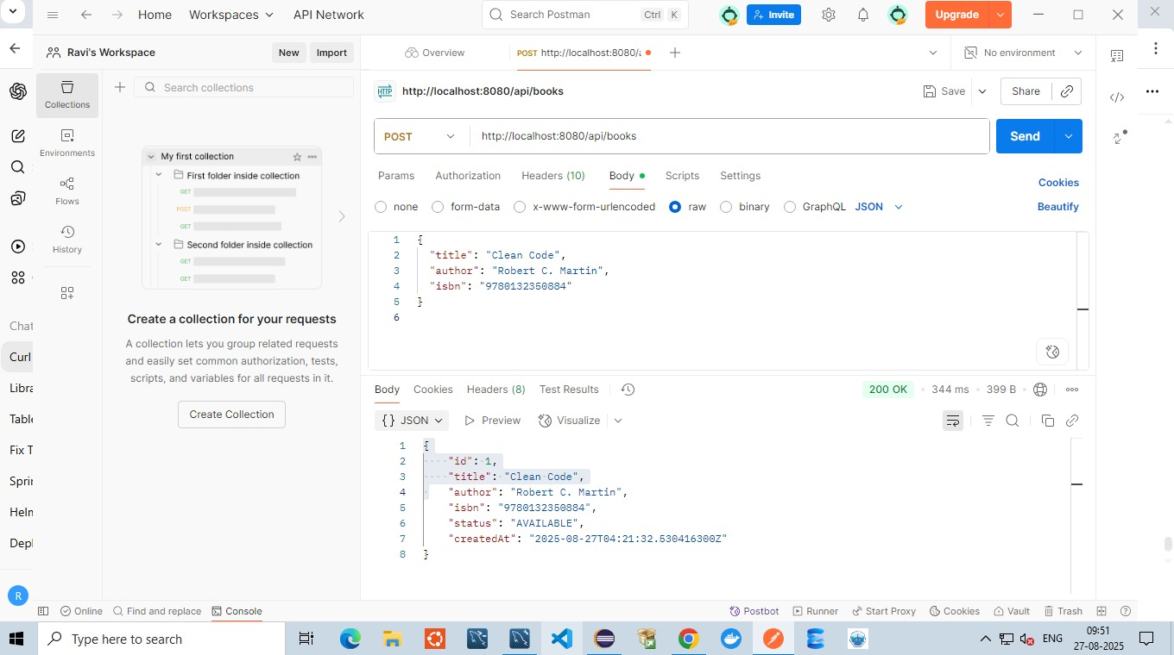
Postman

Slide 7
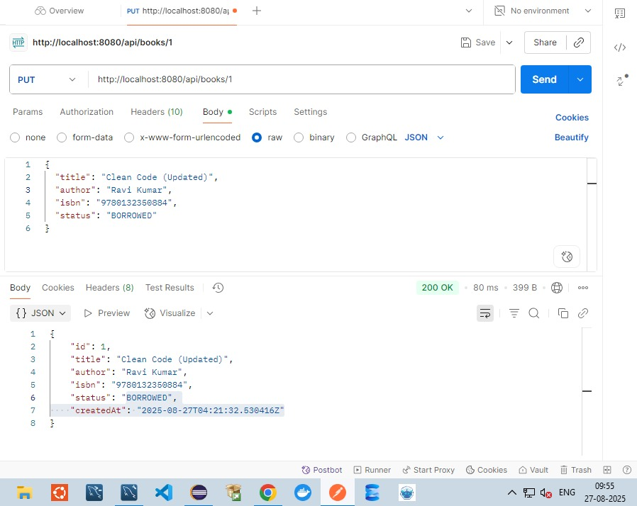

Slide 8
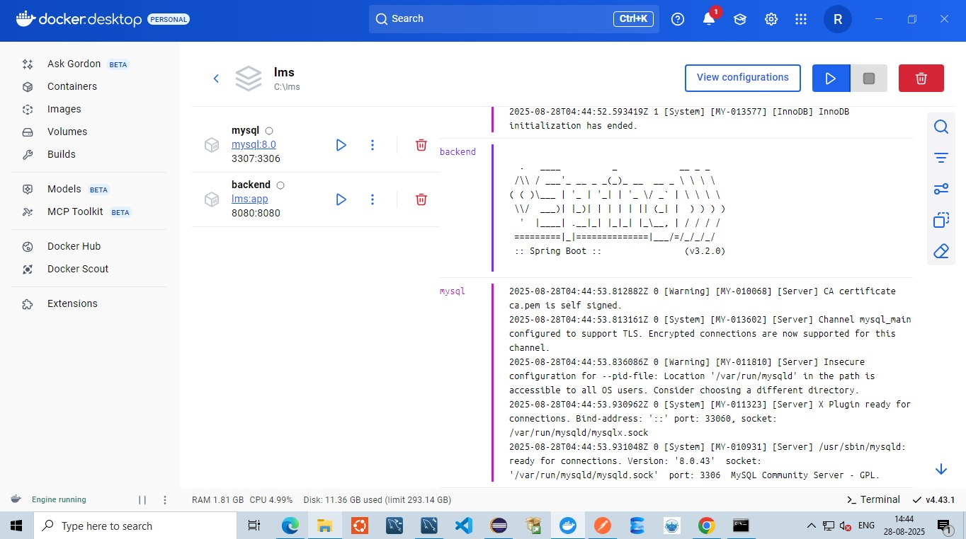
Docker

Slide 9
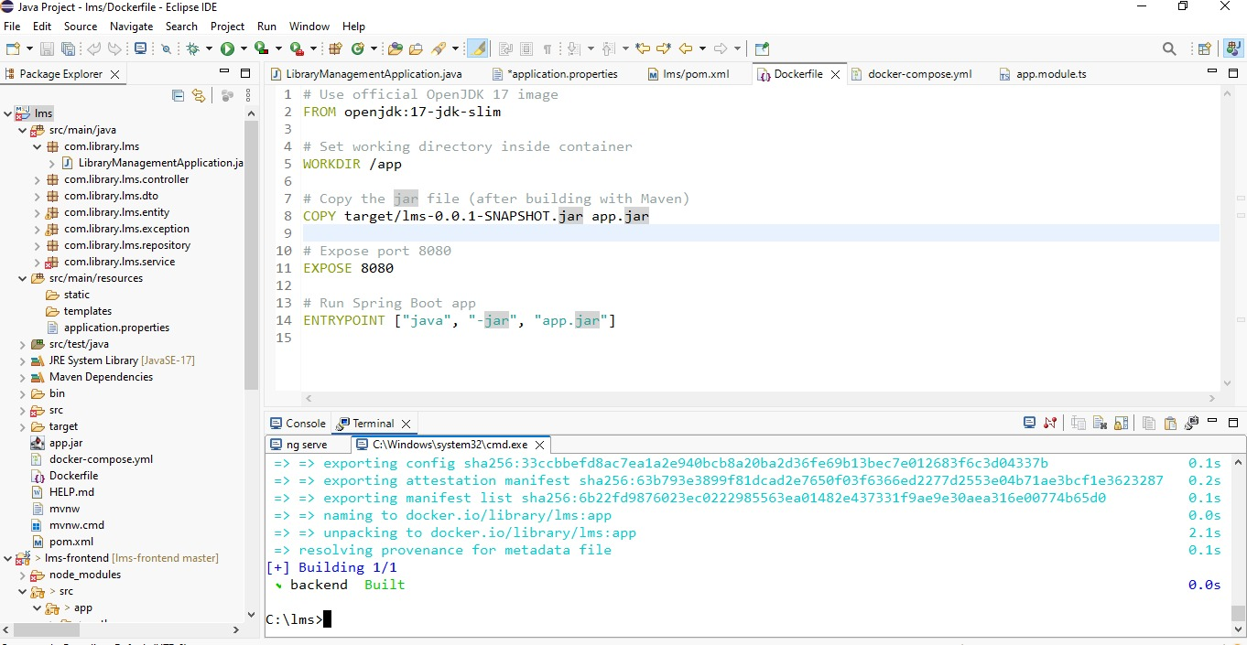
Kubernates

Slide 10
